Slide 1
SMARTS
Storm Water Multiple Application and Report Tracking System

Slide 2
Today’s Agenda
9-9:15 Greetings and slide show
9:15 – 10:30 manual overview (this portion may vary depending on participation from attendees)
10:30 – 10:45 Questions and Answers
11:00 Adjourn

Slide 3
SMARTS
Internet based system
For use by anyone subject to the CGP (MS4?)
Application for permit coverage
Reporting system
Termination
State and Regional water quality control board regulation
Public review and regulation

Slide 4
SMARTS - Access
LRP – Legally Responsible Person
AS – Assigned Signatory
DS/DEP – Data Submitter/Data Entry Person
Administrator
Public

Slide 5
SMARTS - Roles
LRP – Legally Responsible Person
  Project proponent
  Posses a real property interest
  Where multiple entities can serve, select one
  Responsible for compliance with the permit
  Certifies
  In Caltrans: the District Director
  Can designate (link) a back-up LRP (up to 3 each)
  Deputy District Director can be a back up LRP

Slide 6
SMARTS - Roles
AS – Assigned Signatory
  Authorized by the LRP to sign, certify and submit PRDs, NOT and other documents
  “a principal executive officer with managerial responsibility over the construction” project (including …project engineer, …, resident engineer)
  Can be
    RE, PE, CSWC, NPDES Coordinator, RW CM, ACE, CM
  Cannot be the contractor

Slide 7
SMARTS - Roles
Data Submitter or Data Entry Person
  Assigned the role by the LRP or the AS
  Allowed to enter data or upload documents; cannot certify the data/documents
  Inspector, office staff
  As discussed in CPB 12-2, cannot be contractor

Slide 8
SMARTS - Roles
Administrator
  Limited to SWRQB and RWQCB staff
Public
  Viewing of information uploaded and certified in the system
  Cannot view uncertified material

Slide 9
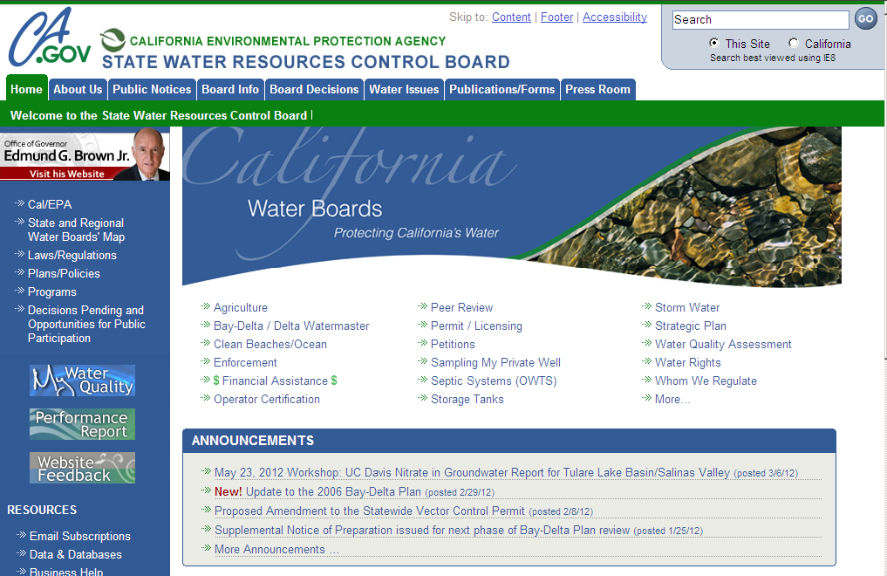
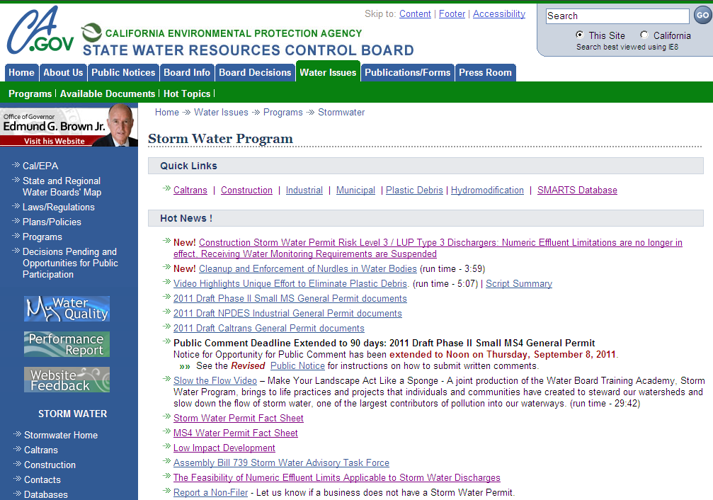
Finding SMARTS

Slide 10
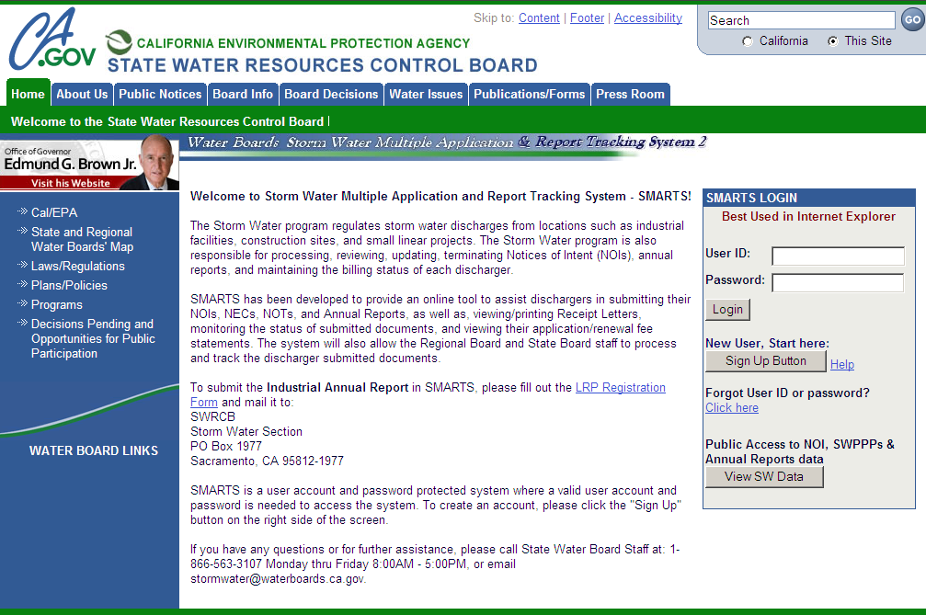
Establish an ID
https://smarts.waterboards.ca.gov/smarts/faces/SwSmartsLogin.jsp

Slide 11
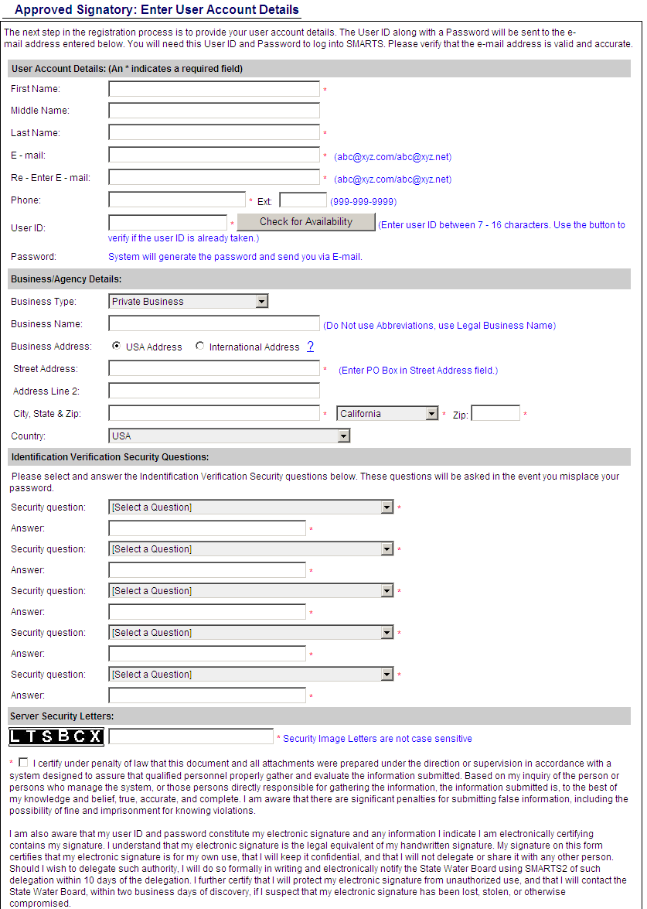
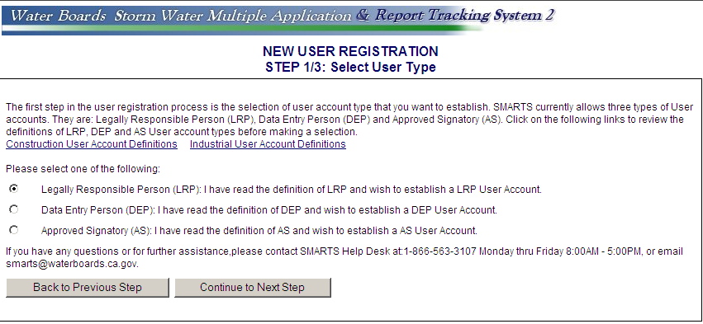
Establish an ID
“sxxxxxxx”
“State Agency”
“Caltrans District xx”
Email to follow with temporary password – log back in and change password.
CEM 2006 still required
Notes:
District director’s first name. backup LRP use the same process
District director’s middle name (optional) backup LRP use the same process.
District director’s last name backup LRP use the same process.
Use LRP_Caltrans_District_XX@dot.ca.gov (see Appendix A backup LRP use their own email address)
District director’s public phone number. backup LRP use the same process
District director chooses unique ID (then check for availability). backup LRP use the same process
Select Government in the Business Type pulldown menu.
Use: Caltrans District XX. backup LRP use the same process
Mark USA address.
Use district address.
Use district city.
California.
Use district zip code.

Slide 12
Request to be linked
Linking = authorizing
LRP can link
  AS(s)
  DEP(s)
AS can link
  DEP(s)
Email request with access level and project to LRP/AS

Slide 13
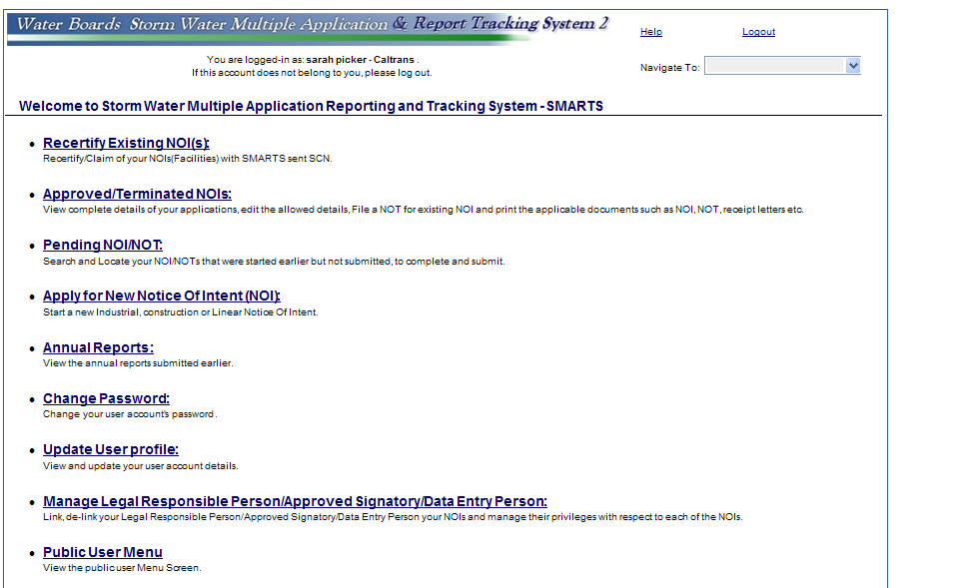
Request to be linked

Slide 14
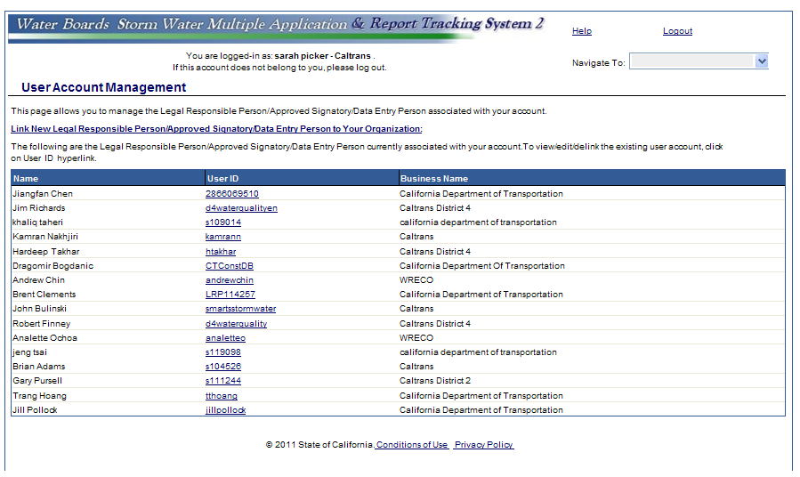
Request to be linked

Slide 15
Reporting
NOI – Notice of Intent
  Replaces NOC – Notice of Construction CEM 2002, CEM-2004
  Various Permit Registration Documents (PRDs)
  SWPPP
Ad Hoc Reports
  Discharges
Annual Report
NOT – Notice of Termination
  Replaces NOCC – Notice of Completion of Construction

Slide 16
Schedule
Start date April 1, 2012
Based on March 31 CPB 12-2 Initiating, Terminating, and Reporting on Projects Subject to the Provisions of the Construction General Permit
Remember, September 2, 2012 Annual Reports due to SMARTS

Slide 17
SMARTS Steps
Step 1 : Establish SMARTS User Accounts, Create Organization ID, Link
Step 2: NOI Submittal and Certification: Enter project specific into SMARTS electronic system
Step 3 Continuous or Ad Hoc Reporting
Step 4: Annual Reports
Step 5: Closeout, NOT
Step 6 : Erosivity Waiver

Slide 18

Resources
Construction Division
www.dot.ca.gov/hq/construc/stormwater
Division of Environmental Analysis
www.dot.ca.gov/env/stormwater
SWRCB www.waterboards.ca.gov/water_issues/programs/stormwater/

Slide 19
Questions
Joyce Brenner, Chief Water Quality
Robert Effinger, Chief Environmental Compliance and Training
Tim Sobelman Chief Design - Stormwater
Hamid Hakim, Construction Storm water Coordinator
Sarah Picker – Environmental Compliance and Training 916 719-4070

