Slide 1
SMARTS Training
definitions
CGP transition plan
Pilot project discussion
SMARTS Manual review

Slide 2
SMARTS Training Agenda
9:00 – 9:05 Introductions
9:05 – 9:15 Who is my audience
9:15 – 9:20 Where to find information
9:20-10:30 Presentation
10:30-10:45 Break
10:45 – 11:30 Questions and Answers

Slide 3
definitions
CGP
SMARTS Manual Appendix A -Acronyms
Includes PRDs
Risk Level Determination
Legally Responsible Person
Common plan of development
Qualified SWPPP Developer (QSD)
Waste Discharge Identification #
SMARTS
Ad Hoc Reporting
Organization ID
User ID
Application ID

Slide 4
State Water Board’s Storm Water Multi Application System (SMARTS)
Electronic file (e-file) permit compliance documents
Documents called Permit Registration Documents (PRDs)
Internet based platform
Self-reporting system
Not only Caltrans projects, other CGP projects and industrial permit projects
Transition from paper based compliance documents

Slide 5
Who is my audience and Where to find information
LRP Table 7/14/2011 email
August 17, 2011 CGP Webinar
NPDES/MS4 Permit information
Windows media player of this slide show
SMARTS Manual
Questions and Answers

Slide 6

Construction General Permit Transition Plan (CGP)-SMARTS Process
Memo from Malcolm Daugherty, Fall 2010
Existing paper based regulatory process converting to electronic submittals
Affects District Directors, Resident Engineer, Division of Environmental Analysis, Construction Division
Self-reporting for permit compliance
/
Notes:
Kamran Njihiri

Slide 7
State Board’s New CGP Requirements for Caltrans
All projects will continue to be covered by the current Caltrans MS4 permit at least until the Caltrans MS4 permit is reissued approx Dec 2011
Submitting Notices of Construction (NOCs) to the Regional Boards is still in effect
Electronic filing of PRDs is not currently required
Caltrans’ construction contract administration must be in compliance with the CGP
  Construction Procedure Directives 10-4 and 10-9 , 11-2 implemented

Slide 8
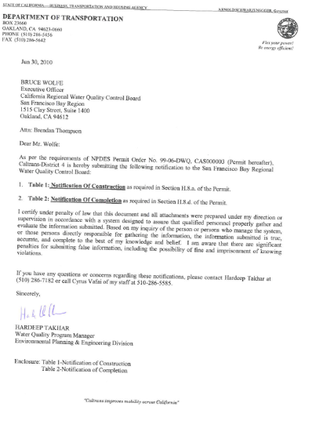
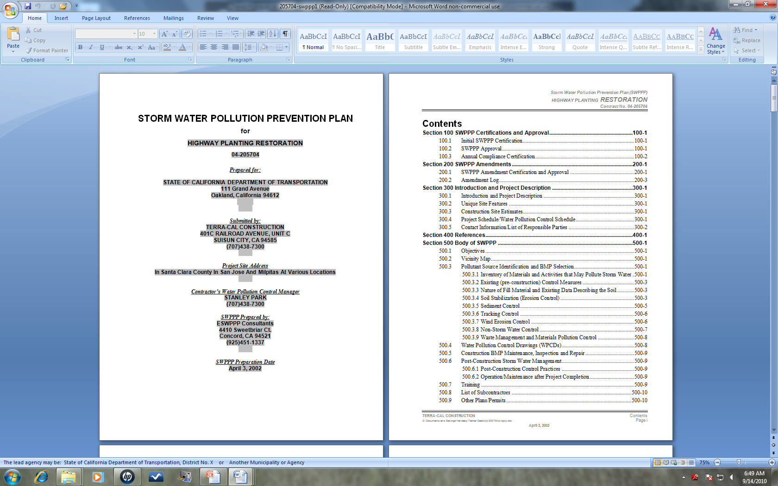
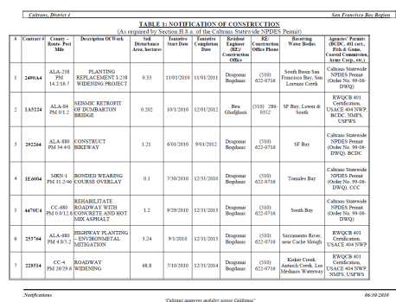
Old Process for Obtaining Coverage under CGP
District NPDES Coordinator
Files Notification of Construction (NOC) with Water Board 30 days prior to beginning of Construction
Resident Engineer reviews and certifies -
  Contractor’s Storm Water Pollution Prevention Plans (SWPPP)
District NPDES Coordinator
  Files Notification of Completion of Construction (NOCC)
Contract Award

Slide 9
Basic Plan
State Board’s Construction Database
- SMARTS
LRP to establish user accounts in SMARTS
Construction Assigned Signatories review, certify and upload the following documents on to SMARTS -
  Contractor’s (SWPPP)
  Ad Hoc (Monitoring Reports)
  Storm Water Annual Report
  Notice of Termination (NOT)
LRP to delegate authority to Backup LRPs and/or Assigned Signatories to file PRDS.
Contract Award
PE or Environmental Water Quality Assigned Signatories uploads PRDs onto SMARTS:
Notice of Intent (NOI)
Site Maps
Risk Level Determination

Slide 10
On going Construction Contracts Plan
State Board’s Construction Database
- SMARTS
LRP to establish user accounts in SMARTS
Construction Assigned Signatories , RE uploads PRDs onto SMARTS:
Site Maps
Risk Assessment
Contractor’s (SWPPP)
  Monitoring Reports
  certify
LRP to delegate authority to Backup LRPs and/or Assigned Signatories to file PRDS.

Slide 11
State Water Board’s Storm Water Multi Application System (SMARTS)
Electronic file (e-file) permit compliance documents
Documents called Permit Registration Documents (PRDs)
Internet based platform
Self-reporting system
Not only Caltrans projects, industrial permits
Transition from paper based compliance documents

Slide 12
Schedule
Now
Hard start date January 1, 2012

Slide 13
Roles
LRP, one
Backup LRP; up to three
Assigned signatory; no limit
Data Submitter; no limit
District Director
Deputy Directors, NPDES Coordinator
Resident Engineer, Construction Storm water Coordinator, District NPDES Coordinator
Inspector
QSD
QSP

Slide 14
SMARTS Steps
Step 1 : Establish SMARTS User Accounts, Create Organization ID, Link
Step 2: NOI Submittal and Certification: Enter project specific into SMARTS electronic system
Step 3 Continuous or Ad Hoc Reporting
Step 4: Annual Reports
Step 5: Closeout, NOT
Step 6 : Erosivity Waiver

Slide 15
SMARTS Manual
To assist RE in compliance
Describe steps
where data comes from
Screen shots
Total SMARTS for GCP has six steps
As of September 8, 2011 Manual address first four steps
Establish User accounts, Create Organization ID and Link
NOI submittal and Certification
Continuous or Ad Hoc Reporting
Annual report

Slide 16
Steps
Step 1 Establish SMARTS User Accounts, Create Organization ID and Link
Step 2: NOI Submittal and Certification
Step 3 Continuous or Ad Hoc Reporting
Step 4 Annual Report

Slide 17
Permit Registration Documents Defined in CGP are
Notice of Intent (NOI)
Risk Level Determination
Site Maps
and Storm Water Pollution Prevention Plan.
The subtlety is that in SMARTS, the NOI PRD is really the process of providing and entering data, uploading attachments using NOI entry tabs and certification

Slide 18
Construction General Permit
Before July 1, 2010 and currently for some projects, Caltrans uses hard paper Notice of Construction.(NOC)
Now, SMARTS requires Notice of Intent (NOI) due seven days before construction begins.

Slide 19
PRDs
The new PRD is the Risk Level Determination.
Risk Level Determination is done in the SWDR process
Caltrans ongoing construction projects should seek assistance from PE or Water Quality staff

Slide 20
SMARTS
Necessary information for SMARTS 1) name and telephone number for WPC manager, 2) email address for the RE and 3) name of Qualified SWPPP Developer.

Slide 21
SMARTS
The PRD called “SWPPP “ is created by the contractor and submitted for approval by the RE. Once this report is approved by Caltrans, it can be uploaded into SMARTS as an pdf attachment.
Pdf attachment file size limit of 75 MB. If any report is larger, the document must be split into pieces of 75MB each and uploaded as a group (1/2, 2/2).
The actual certification by the RE is done after the SWPPP is attached in the attachments tab
Certification is part of NOI tabs.

Slide 22
Steps
Open SMARTS Manual
Step 1 User registration, Link page 6
Step 2 NOI page 15
Step 3 Continuous or Ad Hoc page 32
Step 4 Annual Report page 39

Slide 23
Lessons Learned
Start early
Plan resources for pdf’ing
Get what you can and fill in the blanks as you go
Start at the top
DD time is minimal
All Users will have their own comfort level with system and change

Slide 24

Resources
Construction Division
www.dot.ca.gov/hq/construc/stormwater
Division of Environmental Analysis
www.dot.ca.gov/env/stormwater
SWRCB www.waterboards.ca.gov/water_issues/programs/stormwater/

Slide 25
Questions
Joyce Brenner, Chief Water Quality
Robert Effinger, Chief Environmental Compliance and Training
Tim Sobelman Chief Design - Stormwater
Hamid Hakim, Construction Storm water Coordinator
Sarah Picker – Environmental Compliance and Training 916 653-2833 or 916 719-4070

